Slide 1



Components
Front End Web Server
Back End Web Server
Web Application
ML Engine
Port 80/443
Rest API
Ames Iowa Home Sales
Port 5000
Provides request processing, user input edits, request/response management from the ML Engine, Sorting and display of multiple results to the user.
Loads the Ames Iowa data set on startup and maintains it in memory. Data set is loaded remotely from Kaggle, or could be loaded from local file system as well.

Slide 2
API Interactions (Front end to Back End)
The front end will:
Validate user inputs
Translate user inputs into values expected by the model
Package the request as a json object
Request pricing prediction from the ML Engine
Track the results to allow the user to compare different scenarios
The back end will:
Receive pricing requests packaged as a json object
Validate the requests
Price the requests
Generate and return a pricing response

Slide 3
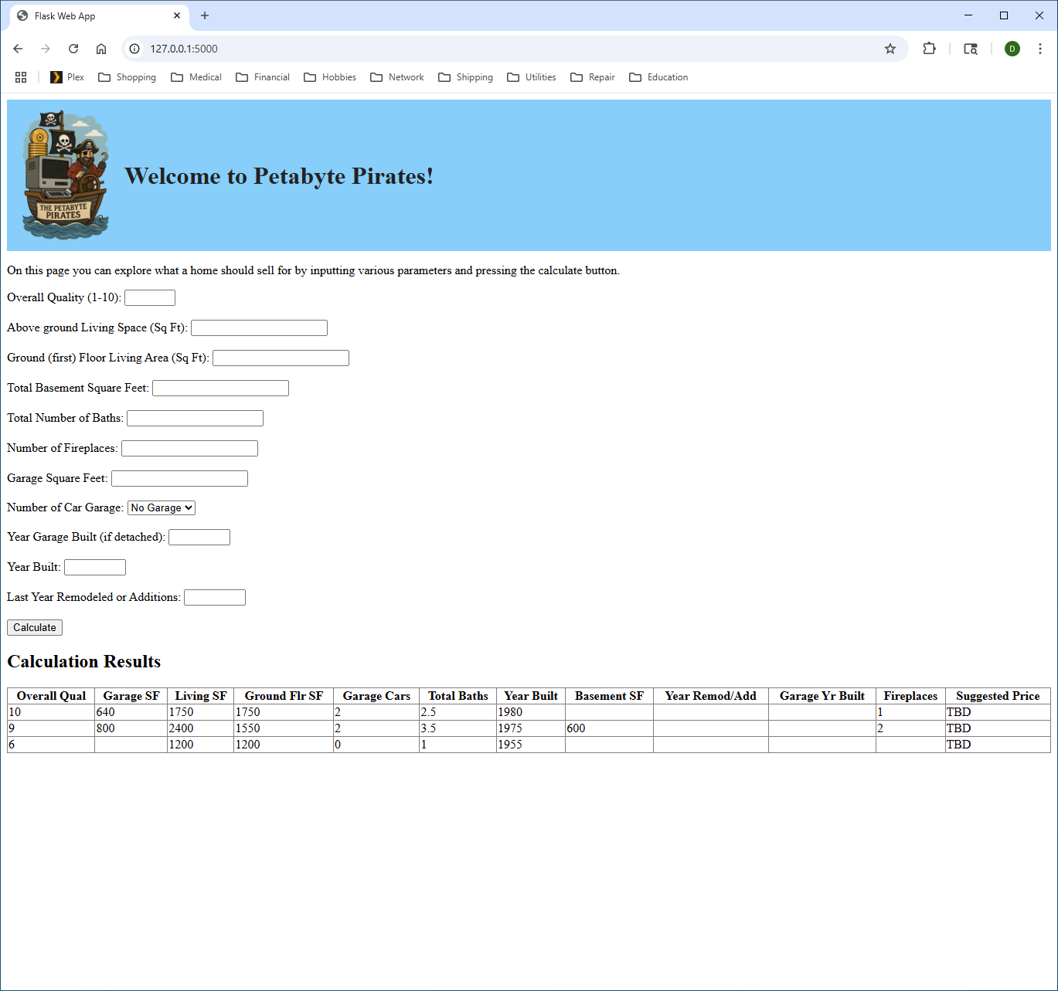
User Presentation Concept
Form for user to input parameters to predict price of home. The result of each request is saved as a table below, allowing “what-if” comparisons.
Each result of the input calculation is saved in a table. All columns of the table are sortable. This allows the user to perform what-if comparisons and to compare multiple properties.

